Slide 1
Structure Programming
ICT-1105
Information and Communication Technology
Lecture-09
Date:

Slide 2
Class contents has given in Google Classroom with code
nhauiw4

Slide 3
Expressions
An expression is a combination of operators and operands which reduces to a single value. An operator indicates an operation to be performed on data that yields a value. An operand is a data item on which an operation is performed.

Slide 4
Expressions
A simple expression contains only one operator.
Ex : 3+5 is a simple expression which yields a value 8,
-a is also a single expression.
A complex expression contain more than one operator.
Ex : complex expression is 6+8*7.

Slide 5
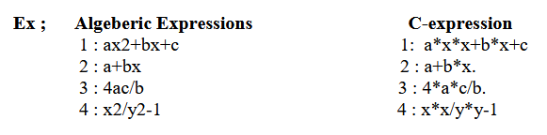
Expressions

Slide 6
Operator Precedence
Arithmetic Operators are evaluated left to right using the precedence of operator when the expression is written without the parenthesis.
They are two levels of arithmetic operators in C.
1 : High Priority * / %
2 : Low Priority + -

Slide 7
Operator Precedence
Arithmetic Expression evaluation is carried out using the two phases from left to right.
1 : First phase : The highest priority operator are evaluated in the 1st phase.
2 : Second Phase : The lowest priority operator are evaluated in the 2nd phase.

Slide 8
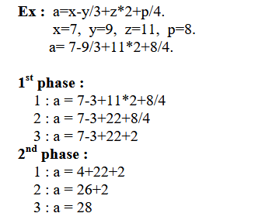
Operator Precedence

Slide 9
Operator Precedence
The order of evaluation can be changed by putting parenthesis in an expression.
Ex : 9-12/(3+3)*(2-1)
Whenever parentheses are used, the expressions within parentheses highest priority. If two or more sets of parenthesis appear one after another. The expression contained in the left-most set is evaluated first and the right-most in the last.

Slide 10
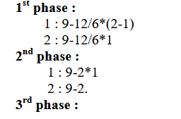

Operator Precedence
Ex : 9-12/(3+3)*(2-1)

Slide 11
Rules for Evaluation of Expression
1. Evaluate the sub-expression from left to right. If parenthesized.
2. Evaluate the arithmetic Expression from left to right using the rules of precedence.
3. The highest precedence is given to the expression with in parenthesis.
4. When parentheses are used, the expressions within parentheses assume highest priority.
5. Apply the associative rule, if more operators of the same precedence occurs.

Slide 12
Operator Precedence and Associativity
Every operator has a precedence value. An expression containing more than one operator is known as complex expression. Complex expressions are executed according to precedence of operators.
Associativity specifies the order in which the operators are evaluated with the same precedence in a complex expression. Associativity is of two ways, i.e left to right and right to left. Left to right associativity evaluates an expression starting from left and moving towards right. Right to left associativity proceeds from right to left.

Slide 13
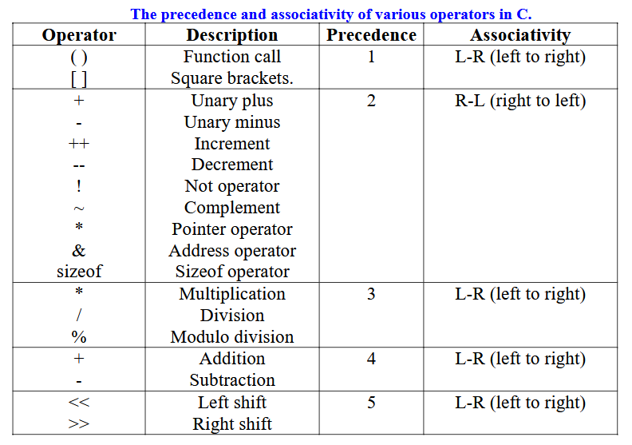

Slide 14
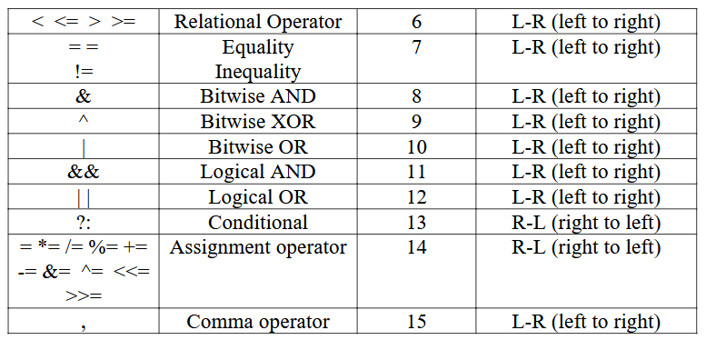

Slide 15
Type Conversion/Type casting
Type conversion is used to convert variable from one data type to another data type, and after type casting complier treats the variable as of new data type.
For example, if you want to store a 'long' value into a simple integer then you can type cast 'long' to 'int'. You can convert the values from one type to another explicitly using the cast operator.
Type conversions can be implicit which is performed by the compiler automatically, or it can be specified explicitly through the use of the cast operator.

Slide 16
Type Conversion/Type casting
Syntax:
(type_name) expression;
Type casting refers to changing an variable of one data type into another. The compiler will automatically change one type of data into another if it makes sense. For instance, if you assign an integer value to a floating-point variable, the compiler will convert the int to a float. Casting allows you to make this type conversion explicit, or to force it when it wouldn’t normally happen.

Slide 17
Type Conversion/Type casting
Type conversion in c can be classified into the following two types:
Implicit Type Conversion
Explicit Type Conversion

Slide 18
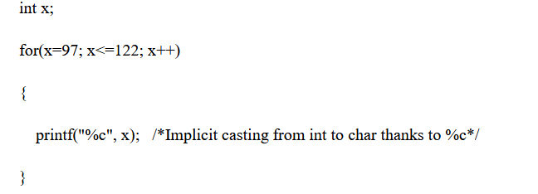
Type Conversion/Type casting
Implicit Type Conversion:
When the type conversion is performed automatically by the compiler without programmers intervention, such type of conversion is known as implicit type conversion or type promotion.

Slide 19
Type Conversion/Type casting
2. Explicit Type Conversion
The type conversion performed by the programmer by posing the data type of the expression of specific type is known as explicit type conversion. The explicit type conversion is also known as type casting.
Type casting in c is done in the following form:
(data_type)expression;
where, data_type is any valid c data type, and expression may be constant, variable or expression.

Slide 20
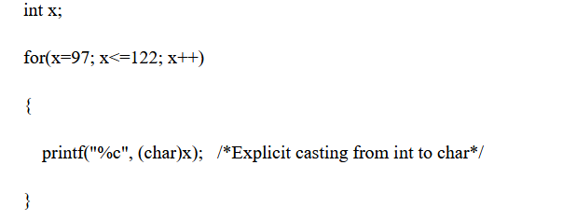
Type Conversion/Type casting
2. Explicit Type Conversion
For example,

Slide 21
Type Conversion/Type casting
The following rules have to be followed while converting the expression from one type to another to avoid the loss of information:
All integer types to be converted to float.
All float types to be converted to double.
All character types to be converted to integer.

Slide 22
Type Conversion/Type casting
Example
Consider the following code:
int x=7, y=5 ;
float z;
z=x/y; /*Here the value of z is 1*/
If we want to get the exact value of 7/5 then we need explicit casting from int to float:

Slide 23
Type Conversion/Type casting
Example
int x=7, y=5;
float z;
z = (float)x/(float)y; /*Here the value of z is 1.4*/

Slide 24
Type Conversion/Type casting
Integer Promotion:
Integer promotion is the process by which values of integer type "smaller" than int or unsigned int are converted either to int or unsigned int. Consider an example of adding a character with an integer.

Slide 25
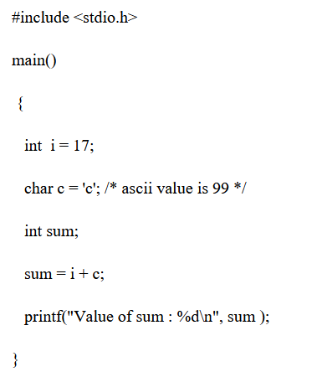
Type Conversion/Type casting
Integer Promotion:

Slide 26
Type Conversion/Type casting
Integer Promotion:
When the previous code is compiled and executed, it produces the following result −
Value of sum : 116
Here, the value of sum is 116 because the compiler is doing integer promotion and converting the value of 'c' to ASCII before performing the actual addition operation.

Slide 27
Type Conversion/Type casting
Usual Arithmetic Conversion
The usual arithmetic conversions are implicitly performed to cast their values to a common type. The compiler first performs integer promotion; if the operands still have different types, then they are converted to the type that appears highest in the following hierarchy

Slide 28
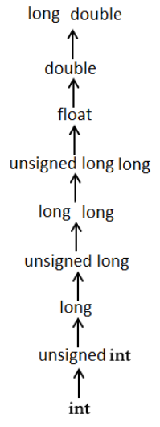
Type Conversion/Type casting
Usual Arithmetic Conversion

Slide 29
Type Conversion/Type casting
Usual Arithmetic Conversion
The usual arithmetic conversions are implicitly performed to cast their values to a common type. The compiler first performs integer promotion; if the operands still have different types, then they are converted to the type that appears highest in the following hierarchy

Slide 31
STATEMENTS
A statement causes the computer to carry out some definite action. There are three different classes of statements in C:
Expression statements,
Compound statements,
and Control statements.

Slide 32
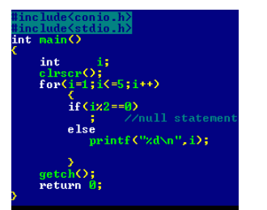
STATEMENTS
Null statement
A null statement consisting of only a semicolon and performs no operations. It can appear wherever a statement is expected. Nothing happens when a null statement is executed.
Syntax: - ;

Slide 33
STATEMENTS
Null statement
Statements such as do, for, if, and while require that an executable statement appear as the statement body. The null statement satisfies the syntax requirement in cases that do not need a substantive statement body.
The Null statement is nothing but, there is no body within loop or any other statements in C.

Slide 34
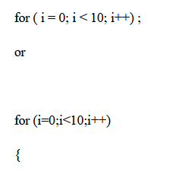
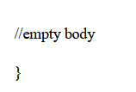
STATEMENTS
Null statement
Example illustrates the null statement:

Slide 35
STATEMENTS
Expression:
Most of the statements in a C program are expression statements.
An expression statement is simply an expression followed by a semicolon.
The lines
i = 0;
i = i + 1;
and printf("Hello, world!\n");
are all expression statements.

Slide 36
STATEMENTS
Expression:
In C, however, the semicolon is a statement terminator. Expression statements do all of the real work in a C program. Whenever you need to compute new values for variables, you'll typically use expression statements (and they'll typically contain assignment operators). Whenever you want your program to do something visible, in the real world, you'll typically call a function (as part of an expression statement). We've already seen the most basic example: calling the function printf to print text to the screen.
Note -If no expression is present, the statement is often called the null statement.

Slide 37
STATEMENTS
Return
The return statement terminates execution of a function and returns control to the calling function, with or without a return value. A function may contain any number of return statements. The return statement has
syntax: return expression(opt);
If present, the expression is evaluated and its value is returned to the calling function. If necessary, its value is converted to the declared type of the containing function's return value.

Slide 38
STATEMENTS
Return
A return statement with an expression cannot appear in a function whose return type is void .
If there is no expression and the function is not defined as void , the return value is undefined.
For example, the following main function returns an unpredictable value to the operating
system:
main ( )
{
return;
}

Slide 39
STATEMENTS
Compound statements
A compound statement (also called a "block") typically appears as the body of another statement, such as the if statement, for statement, while statement, etc.

Slide 40
STATEMENTS
Compound statements
A Compound statement consists of several individual statements enclosed within a pair of
braces { }. The individual statements may themselves be expression statements, compound statements or control statements. Unlike expression statements, a compound statement does not end with a semicolon. A typical Compound statement is given below

Slide 41
CONTROL STATEMENTS
In C, programs are executed sequentially in the order of which they appear. This condition does not hold true always. Sometimes a situation may arise where we need to execute a certain part of the program. Also it may happen that we may want to execute the same part more than once. Control statements enable us to specify the order in which the various instructions in the program are to be executed. They define how the control is transferred to other parts of the program. Control statements are classified in the following ways:

Slide 42
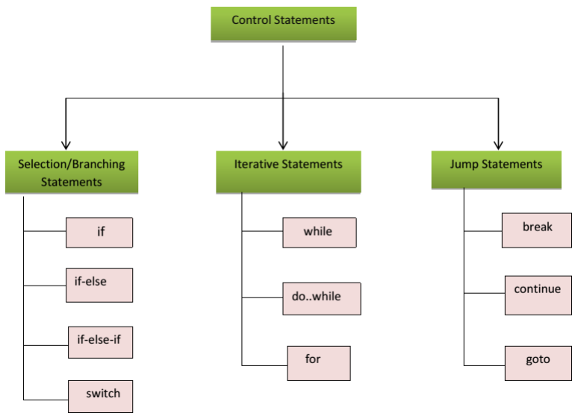
CONTROL STATEMENTS
Classification of control statements

Slide 43
CONTROL STATEMENTS
Selection Statement/Conditional Statements/Decision Making Statements:
A selection statement selects among a set of statements depending on the value of a controlling expression.
Or
Moving execution control from one place/line to another line based on condition
Or
Conditional statements control the sequence of statement execution, depending on the value of a integer expression

Slide 44
CONTROL STATEMENTS
Selection Statement/Conditional Statements/Decision Making Statements:
The selection statements are also known as Branching or Decision Control Statements.
Sometime we come across situations where we have to make a decision. E.g. If the weather is sunny, I will go out & play, else I will be at home. Here my course of action is governed by the kind of weather. If it’s sunny, I can go out & play, else I have to stay indoors. I choose an option out of 2 alternate options. Likewise, we can find ourselves in situations where we have to select among several alternatives. We have decision control statements to implement this logic in computer programming

Slide 45
CONTROL STATEMENTS
Selection Statement/Conditional Statements/Decision Making Statements:
Decision making structures require that the programmer specify one or more conditions to be evaluated or tested by the program, along with a statement or statements to be executed if the condition is determined to be true, and optionally, other statements to be executed if the condition is determined to be false.

Slide 46
CONTROL STATEMENTS
Selection Statement/Conditional Statements/Decision Making Statements:
C’ language supports two conditional statements.
1: if
2: switch.

Slide 47
CONTROL STATEMENTS
1: if Statement:
The if Statement may be implemented in different forms.
simple if statement.
if –else statement
nested if-else statement.
else if ladder.

Slide 48
CONTROL STATEMENTS
if Statement:
The if statement controls conditional branching. The body of an if statement is executed if the value of the expression is nonzero. Or if statement is used to execute the code if condition is true. If the expression/condition is evaluated to false (0), statements inside the body of if is skipped from execution.

Slide 49
CONTROL STATEMENTS
if Statement:
Syntax of if statement:
if (condition )
{
Statement 1;
…………..
Statement n;
}
//Rest of the code

Slide 50

CONTROL STATEMENTS
if Statement:
If the condition is true(nonzero), the statement will be executed. If the condition is false(0), the statement will not be executed. For example, suppose we are writing a billing program.

Slide 51
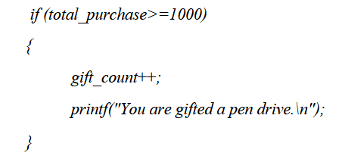
CONTROL STATEMENTS
if Statement:
Multiple statements may be grouped by putting them inside curly braces {}. For example:

Slide 52
CONTROL STATEMENTS
if Statement:
Multiple statements may be grouped by putting them inside curly braces {}. For example:

Slide 53
CONTROL STATEMENTS
if Statement:
Example:
#include<stdio.h>
main()
{
int a=15,b=20;
if(b>a)
{
printf("b is greater");
}
}
Output
b is greater

Slide 54
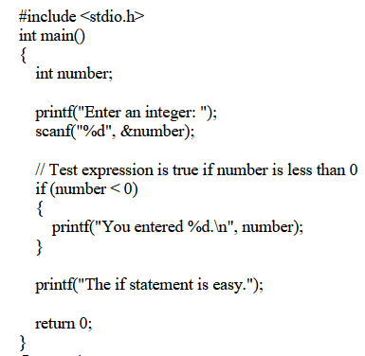
CONTROL STATEMENTS
if Statement:
Example:
Output 1
Enter an integer: -2
You entered -2.
The if statement is easy.
Output 2
Enter an integer: 5
The if statement is easy.

Slide 55
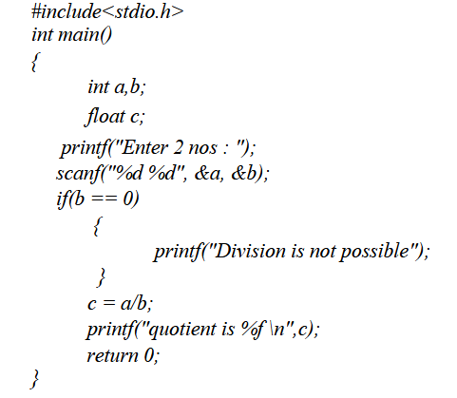
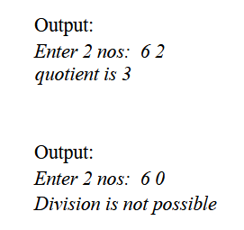
CONTROL STATEMENTS
Write a program to perform division of 2 nos

Slide 56
Thank you….

